Slide 1

C++ Programming Language

Slide 2
Objectives
In this chapter, you will:
• Become familiar with the basic components of
a C++ program, including functions, special
symbols, and identifiers
• Explore simple data types
• Discover how to use arithmetic operators
• Examine how a program evaluates arithmetic
expressions
2

Slide 3
Objectives (continued)
• Learn what an assignment statement is and
what it does
• Become familiar with the string data type
• Discover how to input data into memory using
input statements
• Become familiar with the use of increment and
decrement operators
• Examine ways to output results using output
statements
3

Slide 4
Objectives (continued)
• Learn how to use preprocessor directives and
why they are necessary
• Explore how to properly structure a program,
including
program
using
comments
to
document
a
• Learn how to write a C++ program
4

Slide 5
Structure of a C++ program
Source code
Output
1.
// my first program in C++
2. # include <iostream>
3.
4.
5. {
6. std::cout<<“Hello Word!”;
7. }
Hello Word!
int main ()
5

Slide 6
Components of a C++ program
• Line 1: // my first program in C++
• Lines beginning with two slash signs (//) are
comments by the programmer and have no
effect on the behavior of the program.
short
explanations or observations concerning the
code or program. In this case, it is a brief
introductory description of the program.
•
Programmers
use
them
to
include
6

Slide 7
Components of a C++ program (Cont.)
• Line 2: #include <iostream>
• Lines beginning with a hash sign (#) are
directives read and interpreted by what is
known as the preprocessor.
• In this case, the directive #include <iostream>,
instructs the preprocessor to include a section
of
as
iostream, that allows to perform standard input
and output operations.
standard
C++
code,
known
header
7

Slide 8
Components of a C++ program (Cont.)
• Line 3: A blank line.
• Blank lines have no effect on a program. They
simply improve readability.
8

Slide 9
Components of a C++ program (Cont.)
• Line 4: int main ( )
• This line initiates the declaration of a function.
Essentially, a function is a group of code
statements which are given a name: in this
case, this gives the name "main" to the group
of code statements that follow.
• The execution of all C++ programs begins with
the main function regardless of where the
function is actually located within the code.
9

Slide 10
Components of a C++ program (Cont.)
• Line 6: std::cout << "Hello World!";
• This statement has three parts: First, std::cout,
which identifies the standard character output
device (usually, this is the computer screen).
• Second, the insertion operator (<<), which
indicates
that
into std::cout.
what
follows
is
inserted
• Finally,
world!"),
a
is
sentence
within
quotes
inserted
("Hello
the
standard output.
content
into
the
10

Slide 11
The Basics of a C++ Program
• Function
: collection of statements; when
executed, accomplishes something
− May be predefined
or standard
• Syntax
: rules that specify which statements
(instructions) are legal
• Programming language
: a set of rules,
symbols, and special words
• Semantic rule
: meaning of the instruction
11

Slide 12
Comments
• Comments are for the reader, not the compiler
• Two types:
− Single line
// This is a C++ program. It prints the sentence:
// Welcome to C++ Programming.
− Multiple line
/*
You can include comments that can
occupy several lines.
*/
12

Slide 13
Special Symbols
• Special symbols (Operators)
+
-
*
/
.
;
?
,
<=
!=
==
>=
13

Slide 14
Reserved Words (Keywords)
• Reserved words, keywords, or word symbols
− Include:
• int
• float
• double
• char
• const
• void
• return
14

Slide 15
Identifiers (Variable names)
• Consist of letters, digits, and the underscore
character ( _ )
• Must begin with a letter or underscore
• C++ is case sensitive
− NUMBER is not the same as number
• Two predefined identifiers are cout and cin
• Unlike reserved words, predefined identifiers
may be redefined, but it is not a good idea
15

Slide 16
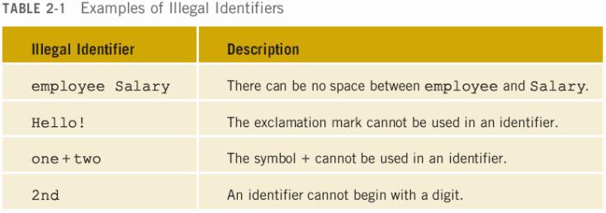
Identifiers (continued)
• The following are legal identifiers in C++:
− First
− convert12
− Pay_Rate
16

Slide 17
Whitespaces
• Every C++ program contains whitespaces
− Include blanks, tabs, and newline characters
• Used to separate special symbols, reserved
words, and identifiers
• Proper utilization of whitespaces is important
− Can be used to make the program readable
17

Slide 18
Simple Data Types
Data Type
Size in Memory
Typical Range (values)
Unsigned integer (int)
4 – Bytes
0 to 4294967295 (~10 digits)
Signed integer
4 – Bytes
-2147483648 to 2147483647
Floating point (float)
4 – Bytes
+/- 3.4e +/- 38 (~7 digits)
Double (double)
8 – Bytes
+/- 1.7e +/- 308 (~15 digits)
Character (char)
1 – Byte
0 to 255
Boolean (bool)
1 – Bytes
True or false
▪ Different compilers may allow different ranges of values
18

Slide 19
int Data Type
• Examples:
-6728
0
78
+763
• Positive integers do not need a + sign
• No commas are used within an integer
− Commas are used for separating items in a list
19

Slide 20
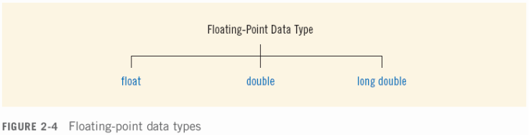
Floating-Point Data Types
− float: represents any real number
• Range: -3.4E+38 to 3.4E+38 (four bytes)
− double: represents any real number
• Range: -1.7E+308 to 1.7E+308 (eight bytes)
− On most newer compilers, data types double
and long double are same
20

Slide 21
Floating-Point Data Types
(continued)
• Maximum number of significant digits
(decimal places) for float values is 7
• Maximum number of significant digits for
double is 15
• Precision
: maximum number of significant
digits
− Float values are called single precision
− Double values are called double precision
21

Slide 22
char Data Type
• The smallest integral data type
• Used for characters
: letters, digits, and special
symbols
• Each character is enclosed in single quotes
− 'A', 'a', '0', '*', '+', '$', '&'
• A blank space is a character and is written ' ',
with a space left between the single quotes
22

Slide 23
bool Data Type
• bool type
− Two values: true and false
− Manipulate logical (Boolean) expressions
• true and false are called logical values
• bool, true, and false are reserved words
23

Slide 24
Arithmetic Operators and Operator
Precedence
• C++ arithmetic operators:
− + addition
− - subtraction
− * multiplication
− / division
− % modulus operator
• +, -, *, and / can be used with integral and
floating-point data types
• Operators can be unary or binary
24

Slide 25
Order of Precedence
• All operations inside of () are evaluated first
• *, /, and % are at the same level of
precedence and are evaluated next
• + and – have the same level of precedence
and are evaluated last
• When operators are on the same level
− Performed from left to right (associativity)
• 3 * 7 - 6 + 2 * 5 / 4 + 6 means
(((3 * 7) – 6) + ((2 * 5) / 4 )) + 6
25

Slide 26
Expressions
• If all operands are integers
− Expression is called an integral expression
• Yields an integral result
• Example: 2 + 3 * 5
• If all operands are floating-point
− Expression is called a floating-point
expression
• Yields a floating-point result
• Example: 12.8 * 17.5 - 34.50
26

Slide 27
Mixed Expressions
• Mixed expression:
− Has operands of different data types
− Contains integers and floating-point
• Examples of mixed expressions:
2 + 3.5
6 / 4 + 3.9
5.4 * 2 – 13.6 + 18 / 2
27

Slide 28
Mixed Expressions (continued)
• Evaluation rules:
− If operator has same types of operands
• Evaluated according to the type of the operands
− If operator has both types of operands
• Integer is changed to floating-point
• Operator is evaluated
• Result is floating-point
− Entire expression is evaluated according to
precedence rules
28

Slide 29
string Type
• Programmer-defined type supplied in
ANSI/ISO Standard C++ library
• Sequence of zero or more characters
• Enclosed in double quotation marks
• Null
: a string with no characters
• Each character has relative position in string
− Position of first character is 0
• Length of a string is number of characters in it
− Example: length of "William Jacob" is 13
29

Slide 30
Input
• Data must be loaded into main memory
before it can be manipulated
• Storing data in memory is a two-step process:
− Instruct computer to allocate memory
− Include statements to put data into memory
30

Slide 31
Declaring & Initializing Variables
• Variables can be initialized when declared:
int first=13, second=10;
char ch=' ';
double x=12.6;
• All variables must be initialized before they
are used
− But not necessarily during declaration
31

Slide 32
Putting Data into Variables
• Ways to place data into a variable:
− Use C++’s assignment statement
− Use input (read) statements
32

Slide 33
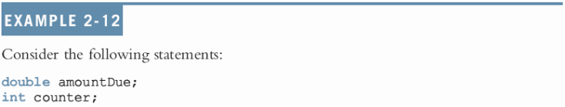

Allocating Memory with Constants
and Variables
• Variable
: memory location whose content
may change during execution
• The syntax to declare a named constant is:
33

Slide 34

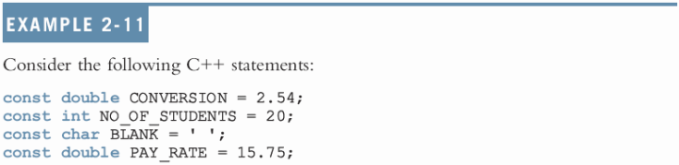
Allocating Memory with Constants
and Variables (continued)
• Named constant
: memory location whose
content can’t change during execution
• The syntax to declare a named constant is:
• In C++, const is a reserved word
34

Slide 35

Assignment Statement
• The assignment statement takes the form:
• Expression is evaluated and its value is
assigned to the variable on the left side
• In C++, = is called the assignment operator
35

Slide 36

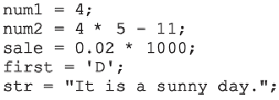
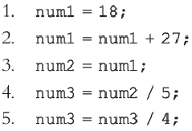
Assignment Statement (continued)
36

Slide 37
Saving and Using the Value of an
Expression
• To save the value of an expression:
− Declare a variable of the appropriate data type
− Assign the value of the expression to the
variable that was declared
• Use the assignment statement
• Wherever the value of the expression is
needed, use the variable holding the value
37

Slide 38

Input (Read) Statement
• cin is used with >> to gather input
• The stream extraction operator is >>
• For example, if miles is a double variable
cin >> miles;
− Causes computer to get a value of type
double
− Places it in the variable miles
38

Slide 39
Input (Read) Statement (continued)
• Using more than one variable in cin allows
more than one value to be read at a time
• For example, if feet and inches are
variables of type int, a statement such as:
cin >> feet >> inches;
− Inputs two integers from the keyboard
− Places them in variables feet and inches
respectively
39

Slide 40
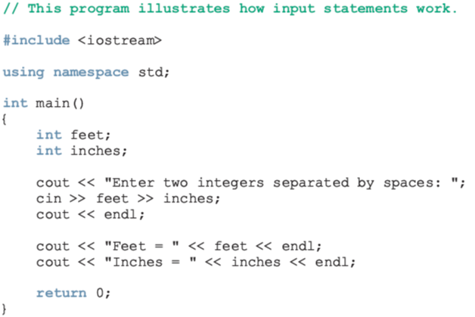
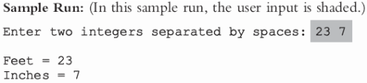
Input (Read) Statement (continued)
40

Slide 41
Variable Initialization
• There are two ways to initialize a variable:
int feet;
− By using the assignment statement
feet = 35;
− By using a read statement
cin >> feet;
41

Slide 42
Increment & Decrement Operators
• Increment operator: increment variable by 1
− Pre-increment: ++variable
− Post-increment: variable++
• Decrement operator: decrement variable by 1
− Pre-decrement: --variable
− Post-decrement: variable—
• What is the difference between the following?
x = 5;
y = ++x;
x = 5;
y = x++;
42

Slide 43
Output
• The syntax of cout and << is:
− Called an output statement
• The stream insertion operator is <<
• Expression evaluated and its value is printed
at the current cursor position on the screen
43

Slide 44
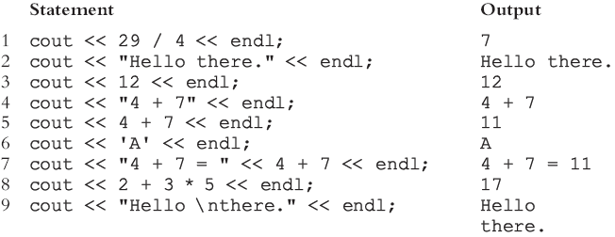
Output (continued)
• A manipulator is used to format the output
− Example: endl causes insertion point to move
to beginning of next line
44

Slide 45
Output (continued)
• The new line character is '\n'
− May appear anywhere in the string
cout << "Hello there.";
cout << "My name is James.";
• Output:
Hello there.My name is James.
cout << "Hello there.\n";
cout << "My name is James.";
• Output :
Hello there.
My name is James.
45

Slide 46
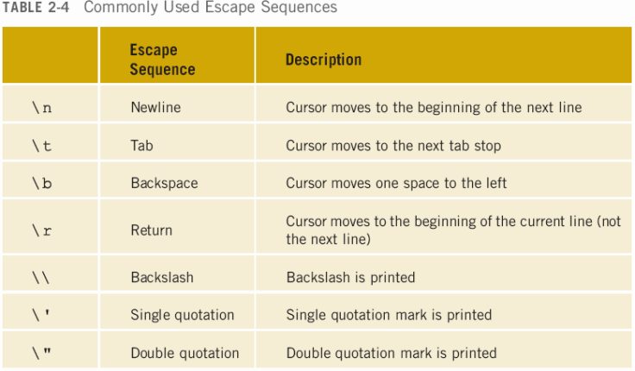
Output (continued)
46

Slide 47
Preprocessor Directives
• C++ has a small number of operations
• Many functions and symbols needed to run a
C++ program are provided as collection of
libraries
• Every library has a name and is referred to by a
header file
• Preprocessor directives are commands
supplied to the preprocessor
• All preprocessor commands begin with #
• No semicolon at the end of these commands
47

Slide 48

Preprocessor Directives
(continued)
• Syntax to include a header file:
• For example:
#include <iostream>
− Causes the preprocessor to include the
header file iostream in the program
48

Slide 49
namespace and Using cin and
cout in a Program
• cin and cout are declared in the header file
iostream, but within std namespace
• To use cin and cout in a program, use the
following two statements:
#include <iostream>
using namespace std;
49

Slide 50
Using the string Data Type in a
Program
• To use the string type, you need to access
its definition from the header file string
• Include the following preprocessor directive:
#include <string>
50

Slide 51
Creating a C++ Program
• C++ program has two parts:
− Preprocessor directives
− The program
• Preprocessor directives and program
statements constitute C++ source code (.cpp)
• Compiler generates object code (.obj)
• Executable code is produced and saved in a
file with the file extension .exe
51

Slide 52
Creating a C++ Program
(continued)
• A C++ program is a collection of functions,
one of which is the function main
• The first line of the function main is called the
heading of the function:
int main()
• The statements enclosed between the curly
braces ({ and }) form the body of the function
− Contains two types of statements:
• Declaration statements
• Executable statements
52

Slide 53
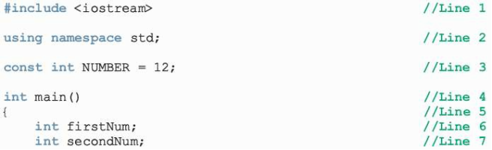
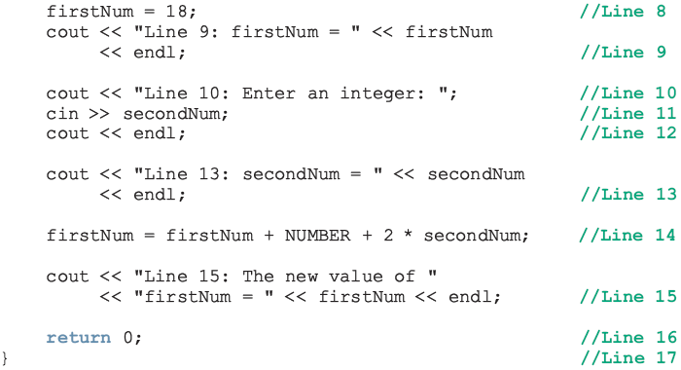
53

Slide 54
Creating a C++ Program
(continued)
Sample Run:
Line 9: firstNum = 18
Line 10: Enter an integer: 15
Line 13: secondNum = 15
Line 15: The new value of firstNum = 60
54

Slide 55
Program Style and Form
• Every C++ program has a function main
• It must also follow the syntax rules
• Other rules serve the purpose of giving
precise meaning to the language
55

Slide 56
Syntax
• Errors in syntax are found in compilation
int x;
int y
//Line 1
//Line 2: error
double z; //Line 3
y = w + x; //Line 4: error
56

Slide 57
Use of Blanks
• In C++, you use one or more blanks to
separate numbers when data is input
• Used to separate reserved words and
identifiers from each other and from other
symbols
• Must never appear within a reserved word or
identifier
57

Slide 58
Use of Semicolons, Brackets, and
Commas
• All C++ statements end with a semicolon
− Also called a statement terminator
• { and } are not C++ statements
• Commas separate items in a list
58

Slide 59
Semantics
• Possible to remove all syntax errors in a
program and still not have it run
• Even if it runs, it may still not do what you
meant it to do
• For example,
2 + 3 * 5 and (2 + 3) * 5
are both syntactically correct expressions, but
have different meanings
59

Slide 60
Naming Identifiers
• Identifiers can be self-documenting:
− CENTIMETERS_PER_INCH
• Avoid run-together words :
− annualsale
− Solution:
• Capitalize the beginning of each new word
• annualSale
• Inserting an underscore just before a new word
• annual_sale
60

Slide 61
Prompt Lines
• Prompt lines
: executable statements that
inform the user what to do
cout << "Please enter a number between 1 and 10 and "
<< "press the return key" << endl;
cin >> num;
61

Slide 62
Documentation
• A well-documented program is easier to
understand and modify
• You use comments to document programs
• Comments should appear in a program to:
− Explain the purpose of the program
− Identify who wrote it
− Explain the purpose of particular statements
62

Slide 63
Form and Style
• Consider two ways of declaring variables:
− Method 1
int feet, inch;
double x, y;
− Method 2
int a,b;double x,y;
• Both are correct; however, the second is hard
to read
63

Slide 64
More on Assignment Statements
• C++ has special assignment statements
called compound assignments
+=, -=, *=, /=, and %=
• Example:
x *= y;
64

Slide 65
Programming Example:
Convert Length
• Write a program that takes as input a given
length expressed in feet and inches
− Convert and output the length in centimeters
• Input
: length in feet and inches
• Output
: equivalent length in centimeters
• Lengths are given in feet and inches
• Program computes the equivalent length in
centimeters
• One inch is equal to 2.54 centimeters
65

Slide 66
Programming Example: Convert
Length (continued)
• Convert the length in feet and inches to all
inches:
− Multiply the number of feet by 12
− Add given inches
• Use the conversion formula (1 inch = 2.54
centimeters) to find the equivalent length in
centimeters
66

Slide 67
Programming Example: Convert
Length (continued)
• The algorithm is as follows:
− Get the length in feet and inches
− Convert the length into total inches
− Convert total inches into centimeters
− Output centimeters
67

Slide 68
Programming Example: Variables
and Constants
• Variables
int feet; //variable to hold given feet
int inches; //variable to hold given inches
int totalInches; //variable to hold total inches
double centimeters; //variable to hold length in
//centimeters
• Named Constant
const double CENTIMETERS_PER_INCH = 2.54;
const int INCHES_PER_FOOT = 12;
68

Slide 69
Programming Example: Main
Algorithm
• Prompt user for input
• Get data
• Echo the input (output the input)
• Find length in inches
• Output length in inches
• Convert length to centimeters
• Output length in centimeters
69

Slide 70
Programming Example: Putting It
Together
• Program begins with comments
• System resources will be used for I/O
• Use input statements to get data and output
statements to print results
• Data comes from keyboard and the output
will display on the screen
• The first statement of the program, after
comments, is preprocessor directive to
include header file iostream
70

Slide 71
Programming Example: Putting It
Together (continued)
• Two types of memory locations for data
manipulation:
− Named constants
• Usually put before main
− Variables
• This program has only one function (main),
which will contain all the code
• The program needs variables to manipulate
data, which are declared in main
71

Slide 72
Programming Example: Body of
the Function
• The body of the function main has the
following form:
int main ()
{
declare variables
statements
return 0;
}
72

Slide 73
Programming Example: Writing a
Complete Program
• Begin the program with comments for
documentation
• Include header files
• Declare named constants, if any
• Write the definition of the function main
73

Slide 74
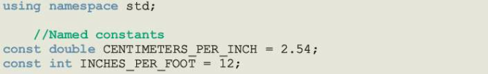
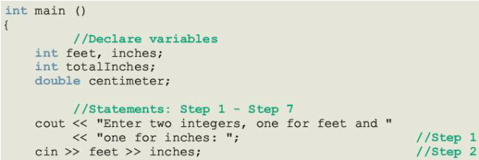
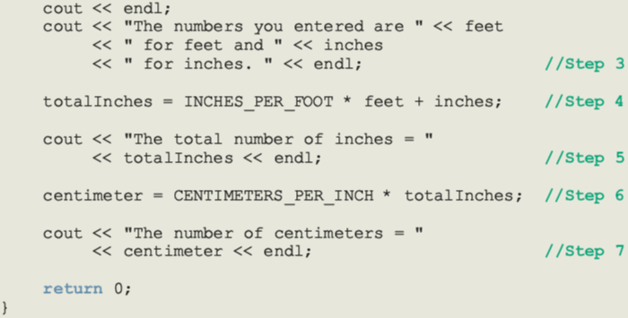
74

Slide 75
Programming Example: Sample
Run
Enter two integers, one for feet, one for inches: 15 7
The numbers you entered are 15 for feet and 7 for inches.
The total number of inches = 187
The number of centimeters = 474.98
75

Slide 76
Summary
• C++ program
: collection of functions where
each program has a function called main
• Identifier consists of letters, digits, and
underscores, and begins with letter or
underscore
• The arithmetic operators in C++ are addition
(+), subtraction (-),multiplication (*), division (/),
and modulus (%)
• Arithmetic expressions are evaluated using the
precedence associativity rules
76

Slide 77
Summary (continued)
• All operands in an integral expression are
integers and all operands in a floating-point
expression are decimal numbers
• Mixed expression
: contains both integers and
decimal numbers
• Use the cast operator to explicitly convert
values from one data type to another
• A named constant is initialized when declared
• All variables must be declared before used
77

Slide 78
Summary (continued)
• Use cin and stream extraction operator >> to
input from the standard input device
• Use cout and stream insertion operator <<
to output to the standard output device
• Preprocessor commands are processed
before the program goes through the
compiler
• A file containing a C++ program usually ends
with the extension .cpp
78

